Slide 1
Welcome to Back to School Night!
Mrs. Schneider
Track B
8:00am - 11:30am

Slide 2
Goals for the Year
Notes:
Language Arts/Writing

Slide 3
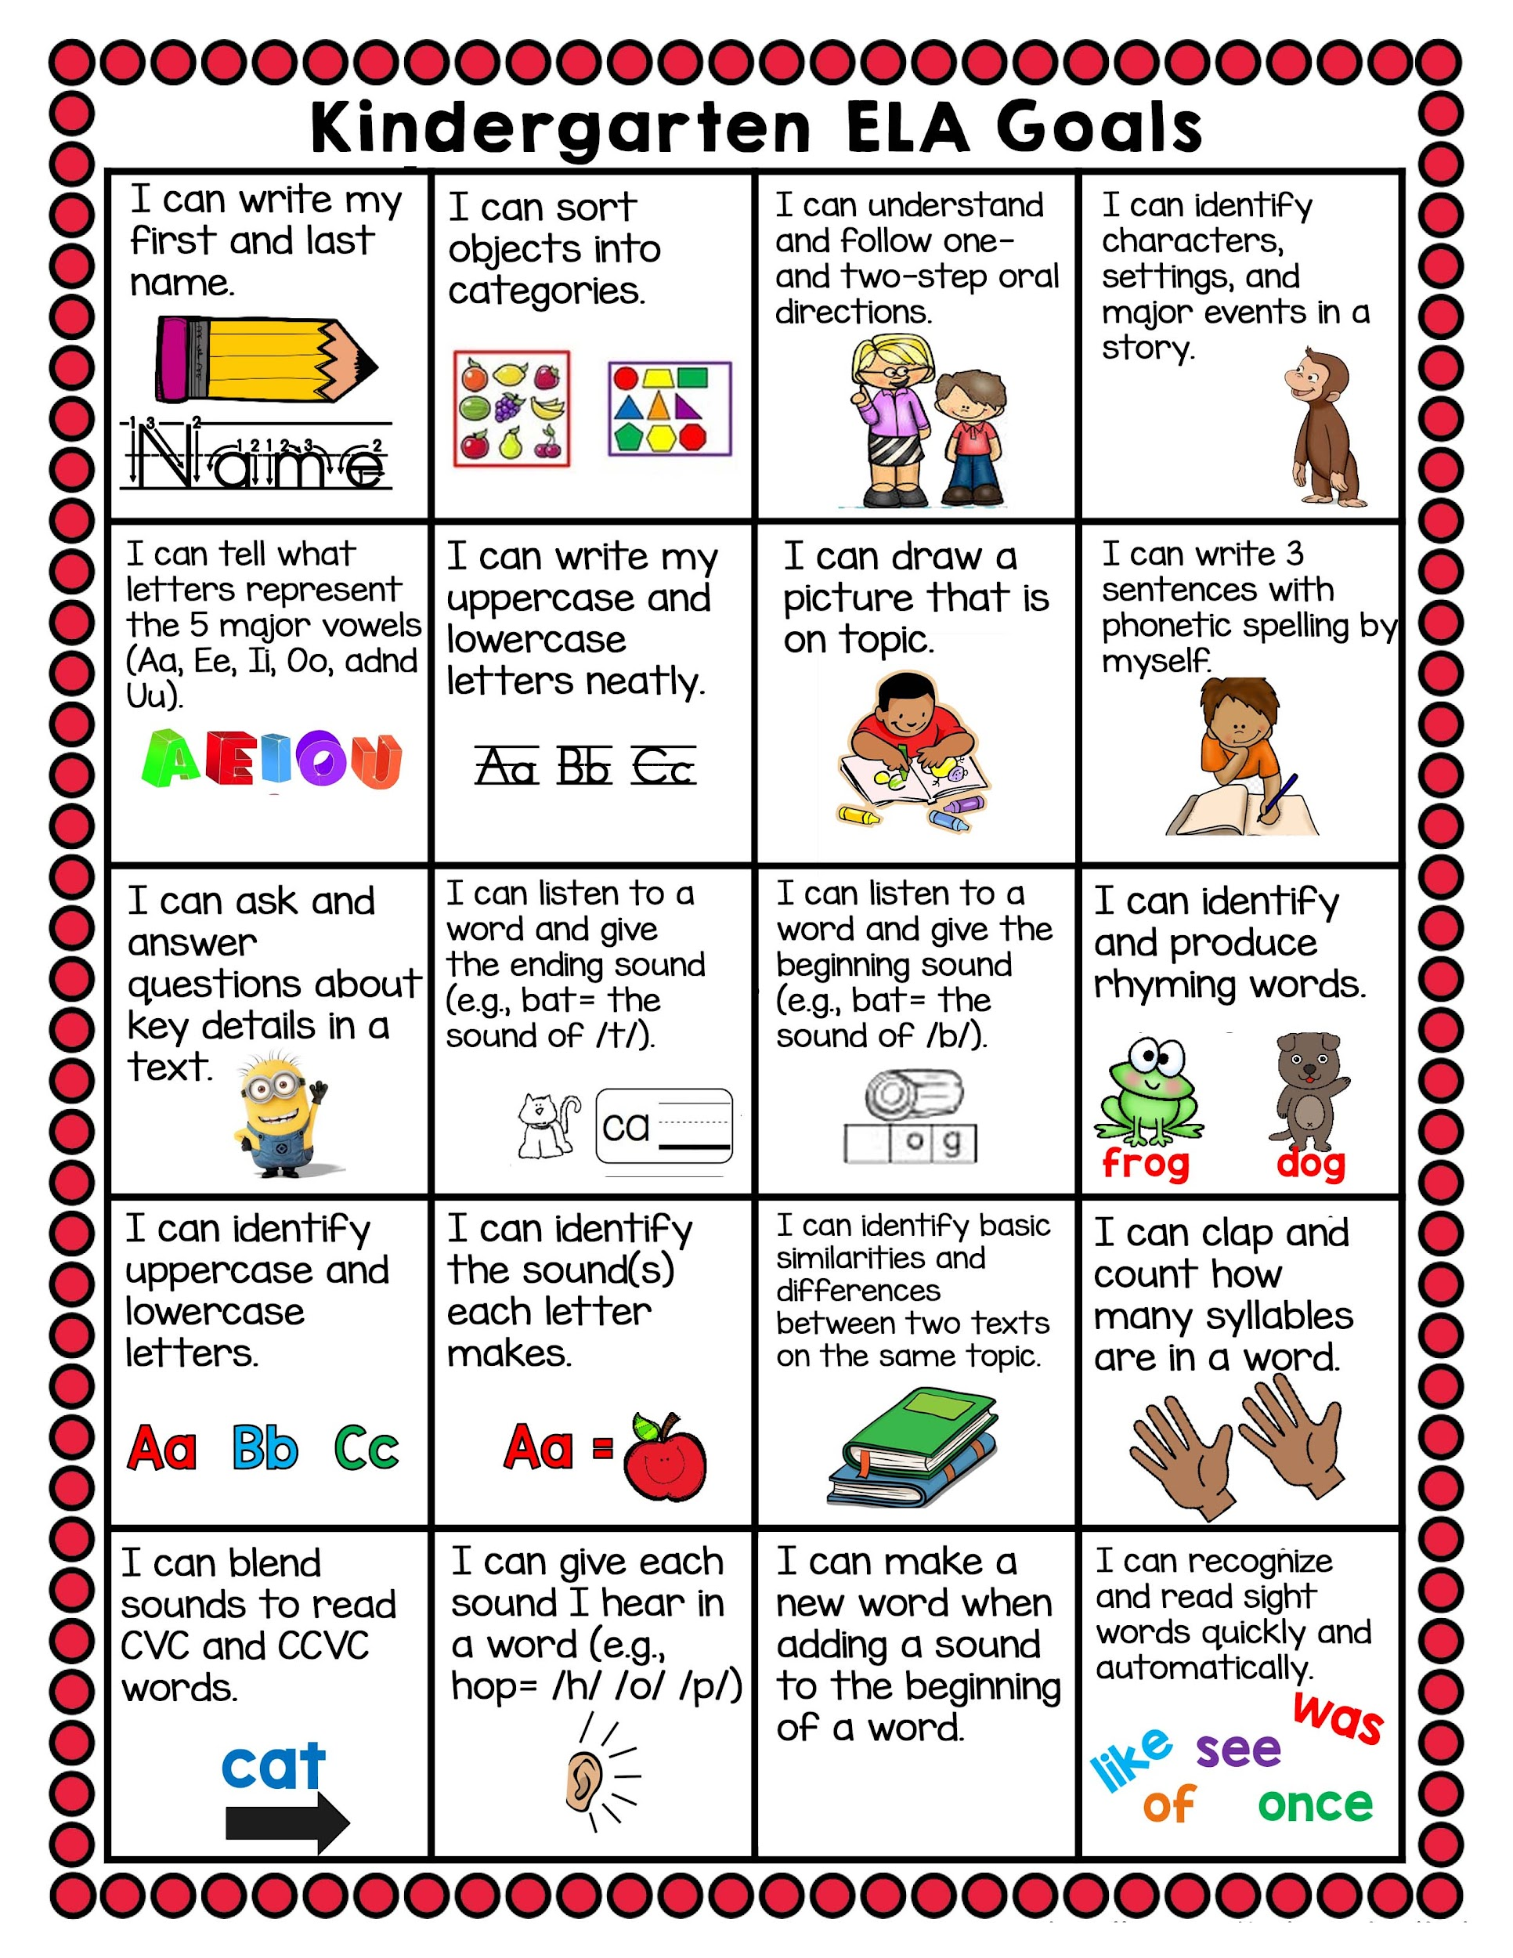

Slide 6
Core Curriculum

Slide 7
Core Curriculum
English Language Arts - Wonders & Alphafriends
Phonics - UFLi
Math - Pearson Savvas Easy Bridge & More
Science- Twig Science
Social/ Emotional- Second Step

Slide 8
Homework

Slide 9
Homework
1. Read a story daily and discuss the story for comprehension.
2. Practice letters, sounds, and sight words.
3. Practice letter formation “top to bottom”
4. Writing Practice: writing name with one capital at the beginning and the rest lowercase. Practice number writing and recognition to 30.
We will send extra practice pages as needed.

Slide 10
Classroom Expectations

Slide 11
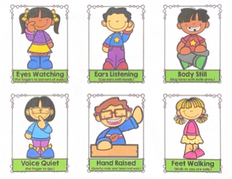
Classroom Behavior Policy
We follow a whole body approach to being a good learner.
Classroom rules:
1. Eyes Watching
2. Ears Listening
3. Voices Quiet
4. Body Still
5. Feet Walking
6. Hand Raised
Positive behaviors are praised… Hand stamp/sticker at the end of the day!
We work on whole class rewards.
If your child is struggling, please know we try multiple corrective models and several reminders before we decide that they don’t get a hand stamp/sticker.

Slide 12
Report Card & Grades
Report Cards will go home at the end of every trimester. The current grading policy is as follows. If a standard has not been completely and explicitly taught , there will be an X.
4 ... Excelling Students at the Excelling level of performance are consistently performing at grade level, can demonstrate independence, and can extend the grade level standards, when applicable, expected at this point of the school year.
3 ... Achieving Students at the Achieving level of performance demonstrate an adequate understanding of and ability to apply skills needed to meet grade level standards expected at this point of the school year.
2 ... Progressing Students at the Progressing level of performance are partially meeting the grade level standards expected at this point in the school year.
1 ... Beginning / Standard Not Met Students at the Beginning/Standard Not Met are not yet meeting the grade level standards expected at this point of the school year

Slide 13
Snacks

Slide 14
Snacks
Children need to bring a small, healthy snack and water bottle each day. NO JUICE, MILK, or SODA.
Your child needs to be able to open their own items. You may need to cut a small corner off of packages to help them.
Please label lunch bags and water bottles with their name.

Slide 15
Birthdays

Slide 16
Birthdays
We love to celebrate everyone’s birthday! We will make your child’s day special in the classroom with singing and a birthday crown. Please refer to student handbook for further details.

Slide 17
Celebrations
We will have 3 parties throughout the year. We thank you in advance for donations to help with food, games, crafts, and decorations.
Stay up to date with class party information through ParentSquare.

Slide 18
Attendance Policy

Slide 19
Attendance Policy
Absences are to be reported to the office. Please call (909)364-2319. We also appreciate a text or email from Parent Square from you to let us know that your child will be absent.
Makeup work is not required. We will save classwork and send it home when your child returns to school.

Slide 20
Schedule
8:00 to 11:30
Monday - Friday

Slide 21
Parent-Teacher Conferences

Slide 22
Parent-Teacher Conferences
August 19, 20, 21
Conferences will be held 12:15pm-2:30pm in the classroom.
We will be sending a sign-up list through ParentSquare.
Please reach out if you cannot make it to the conference.

Slide 23
Volunteers Needed

Slide 24
Volunteer Opportunities
!
Classroom Volunteer: Volunteers will be working with students or prepping materials, as needed. We are also looking for a Room Parent and a Sight Word Assistant.
Take Home Volunteer: I can take home materials to sort, cut, staple or organize.
Please complete a Volunteer Interest Form & return.

Slide 25
Misc. Information
*The Owl Folder should be kept in your child’s backpack. Please check it daily and remove notices and completed work.
*Absolutely NO PARKING or getting out of your vehicle by the curbs in the parking lots. You MUST park in a parking space if you plan to exit your vehicle.
*We show school spirit by wearing Legacy shirts on Fridays. These are available for purchase from PTO. Students that do not have school shirts can wear blue.

Slide 26
Appreciated Donations

Slide 27
Appreciated Donations
Tissues, Clorox wipes, and mini prizes for our prize box would be fantastic!
There is also an Amazon class wish list which can be accessed through the school website.

Slide 28
Teacher Contact Information

Slide 29
Contact Information
Parent Square
Email: Gena_Schneider@chino.k12.ca.us
Legacy Academy Office (909)364-2319
I can not respond to messages during class time, but will respond within 24 hours.

Slide 30
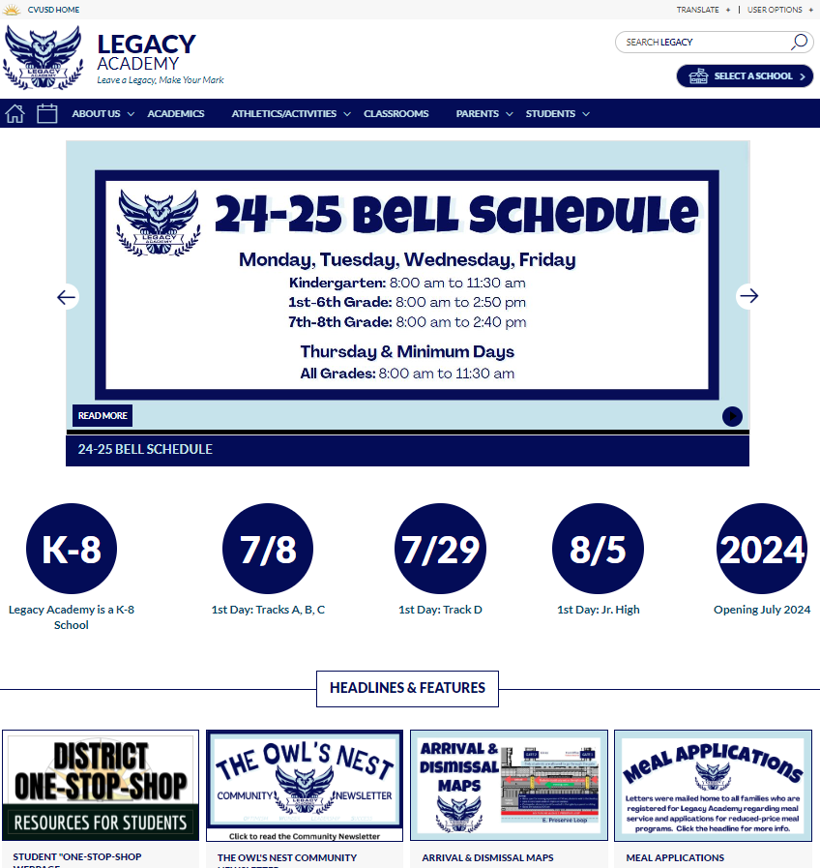
Communication
Legacy Academy Website
www.chino.k12.ca.us/LegacyAcademy
Weekly Newsletter
Every Saturday at 11:30 am in Parent Square
Notes:
We keep our website updated so please make a point to check it often. The Owl’s Nest Weekly Community Newsletter is sent out through Parent Square every Saturday at 11:30 am. Please click the link in the ParentSquare message to be taken to the newsletter.

Slide 31
Parent Handbook
Please read the parent handbook that is posted online. Particular topics will be highlighted each week in the newsletter.
Website -> About Us -> Student Parent Handbook
Student Birthdays & Class Treats
Birthdays can be an exciting time for students, and we want to recognize their special day; our teachers will do their best to verbally recognize birthdays. However, in order to minimize loss of instructional time, and to follow our wellness policy, treats and goodie bags are not to be brought to school. We ask that you do not place a teacher in an awkward position by asking them if you can have a party or bring in cupcakes, cakes, goodie bags, etc.
Gifts/balloons/flowers should not be sent to the school. If these items are brought to school, they will remain in the office until the end of the day.
.
Notes:
Please read the part about birthdays and class treats

Slide 32
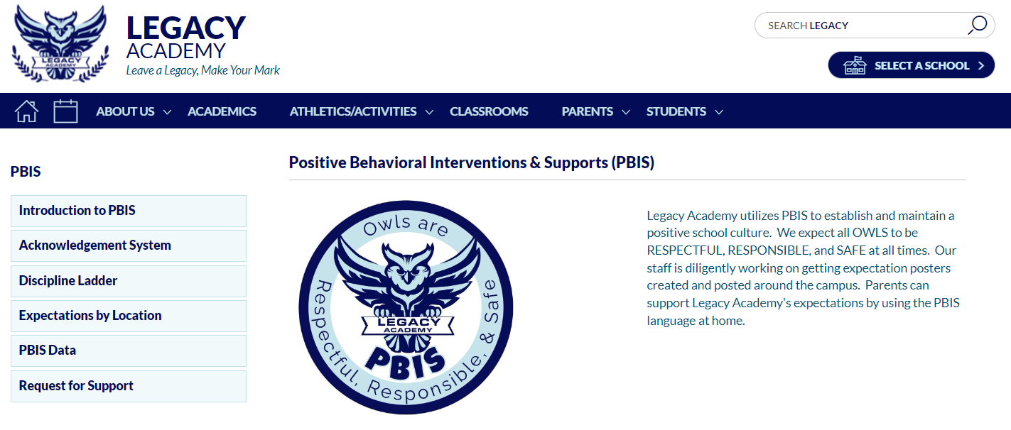
Legacy Academy PBIS Expectations
Notes:
Owls are Respectful, Responsible, and Safe. Point out the Request for Support tab.

Slide 33
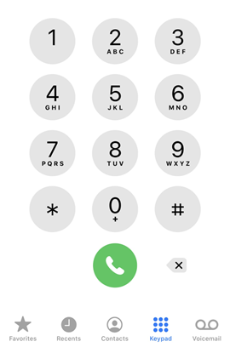
Attendance
Students are expected to be at school (unless it is an excused reason). Each day of school should provide an important learning experience, and if your child(ren) are not in class, they miss the learning continuity.
Board Policy requires a parent verification of each absence within 5 school days of the student’s return to school. On the sixth day, the absence becomes unverified and cannot be changed. State law requires that each absence be cleared.
Please contact the office at (909) 364-2319 to report absences.
Contacting the teacher about an absence is not the same as clearing the absence with the office.
Legacy Academy
(909) 364-2319

Slide 34
CVUSD Student Performance Levels
4 - Excelling: Students at the Excelling level of performance are consistently performing at grade level, can demonstrate independence, and can extend the grade level standards, when applicable, expected a this point of the school year.
3 - Achieving: Students at the Achieving level of performance demonstrate an adequate understanding of and ability to apply skills needed to meet grade level standards at this point of the school year.
2 - Progressing: Students at the Progressing level of performance are partially meeting the grade level standards expected at this point of the school year.
1 - Beginning/Standard Not Met: Students at the Beginning/Standard Not Met level are not yet meeting grade level standards expected a this point of the school year.
Notes:
Standards Based Grading and Report Card Marks

Slide 35
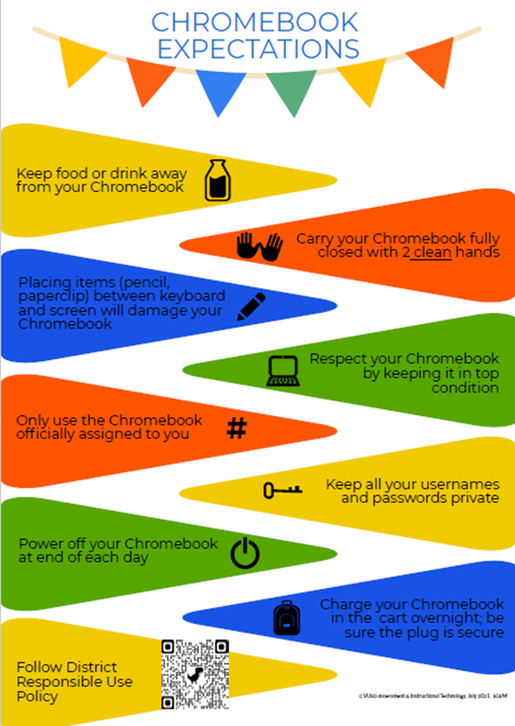
Chromebooks
Students in Kinder - 3rd grade have access to their Chromebook in the classroom.
Charging towers/cabinets are in each room so they can be charged at night.
Students in 4th - 8th grade can take their Chromebooks home to assist with homework.
Devices should be charged at night so they are ready to go each morning. Charging cords can be kept at home.
Chromebooks are checked out to students through our textbook checkout system.
The district offers a device protection plan for lost and damaged devices.

Slide 36
Aeries Parent Portal & Parent Square
CVUSD uses Aeries Parent Portal and Parent Square as communication tools.
ParentSquare is designed to keep parents informed and facilitate participation at schools. It provides a safe way for school principals, teachers, staff, and parents to communicate.
To activate your ParentSquare account, enter your Aeries Parent Portal, tap on Communications, and confirm the data you see there.
The Emergency Card is completed in Aeries Parent Portal. It is critical that you update your emergency contacts for each child so that we have someone to contact if you are unavailable.
Parent Square messages can be delivered in several forms, and parents may choose whichever is the most useful, practical version.
Email
Smartphone app
Phone (voice)
SMS (text) message
Web app within Aeries Parent Portal

Slide 37
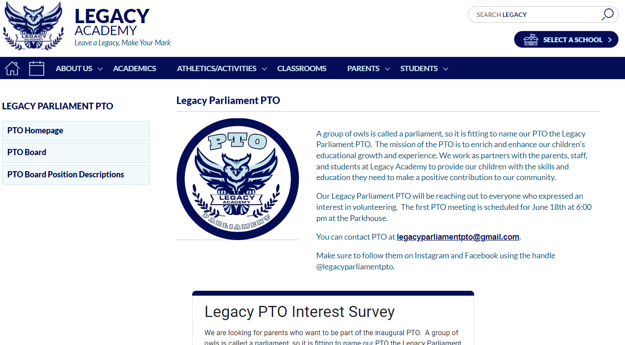
Legacy Parliament PTO
We have a fantastic PTO and strong parent involvement.
Please consider joining PTO this year. Membership drive information will be posted on our website.
Spirit Wear orders will be made available again very soon!

